Slide 1
PHONON
Rajkamal.A
Research scholar,
Dept of physics,
Srm university.
19.11.2014.

Slide 2
Phonon
Phonon fundamentals -Part 1
Phonon calculation in quantum espresso
-Part 2
Program files and results
-Part 3

Slide 3
PHONON
Concept introduced –IGOR TAMM –Russian physicst (1932)
Greek word –sound or voice,because long-wavelength phonons give rise to sound.
The study of phonons is an important part of condensed matter physics.
Major Role – physical properties such as thermal conductivity and electrical conductivity.

Slide 4
Photon –quantization of energy that travels light speed .

Slide 5
Photon –quantization of energy that travels light speed .
PHONON
quantization of vibrational energy.
quantized lattice waves (collective oscillations of atoms)travels sound speed.
If ώ is the frequency of a phonon.
Energy is in integer multiples of ħώ

Slide 6
Definition
a phonon is a collective excitation in a periodic, elastic arrangement of atoms or molecules in condensed matter, such as solids and some liquids.
A phonon is a quantum mechanical description of an elementary vibrational motion in which a lattice of atoms or molecules uniformly oscillates at a single frequency.

Slide 7
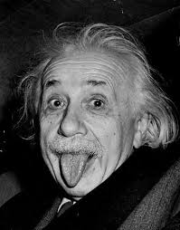
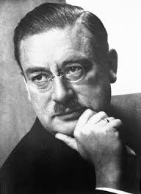
Einstein and Debye – (already)introduced quantization of energy in specific heat of solid.
phonon
lattice itself consider as kind of continuum ….

Slide 8
Dispersion relation
The connection between frequency and wave-vector, ω=ω’(k), is known as a dispersion relation.
frequency- ω
Wave-vector -k,
Velocity of sound- ω’

Slide 9
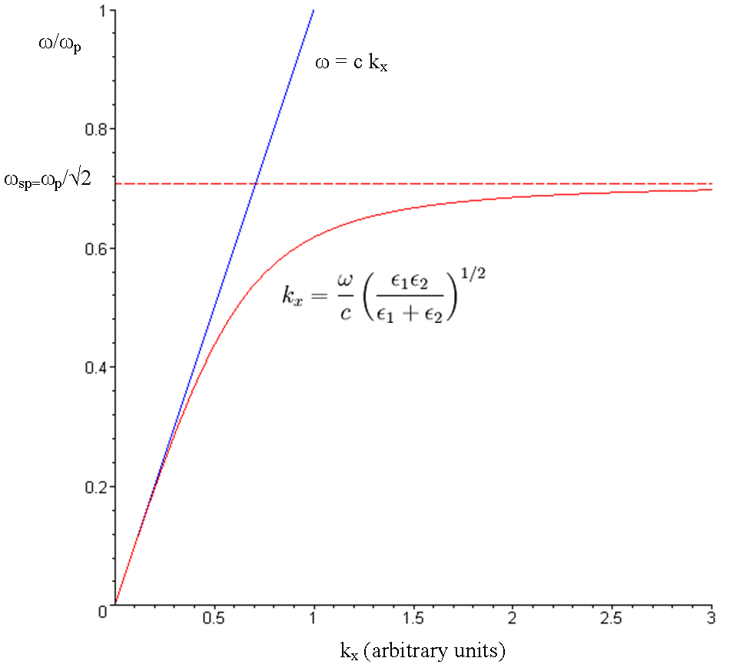
Dispersion relation
Continuum
discrete

Slide 10
Questions? 1.why do we expect this type of deviation? 2.This dispersion relation of frequency and wave no are not occur small or large value of the wave no........why?

Slide 11
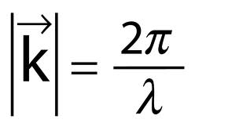
Answer for 2nd question.
Due to this relation….
Some large number of k the wave length approaches interatomic distance.
So wavelength of the wave going through the solid cant be smaller than interatomic distance. So it has upper cutoff.

Slide 12
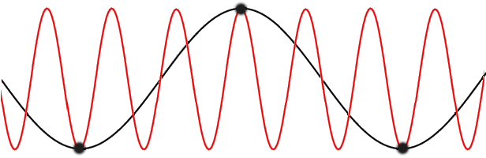
This is how….

Slide 13
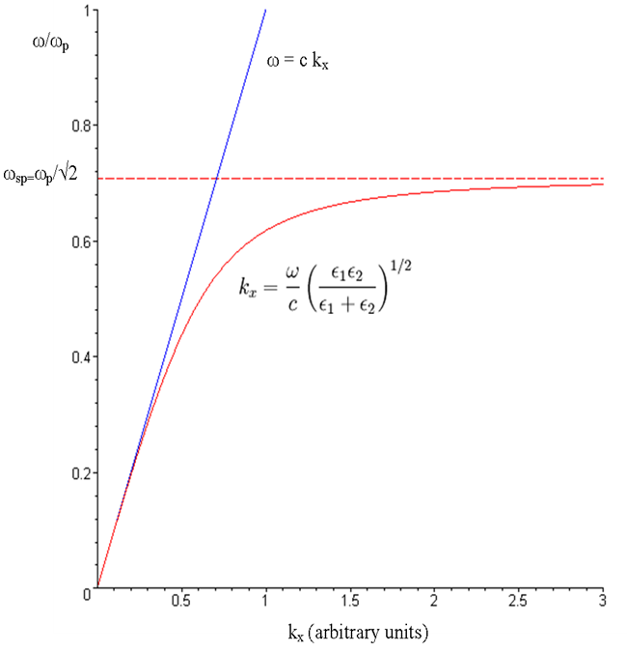
Answer for 1st question
Large number of the k and small value of the wavelength, we expect the continuum of the picture breakdown.

Slide 14
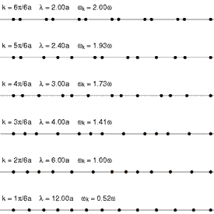
1d-Monoatomic lattice
This is gonna help us to understand the deviation relation of frequency and wave vector.

Slide 15


1d-Monoatomic lattice
Newton force on atom
If we wanted to include more distant neighbour interactions (up to the Nth), our equation at this point would have the form
Going back to nearest neighbours, try a solution of the form

Slide 16

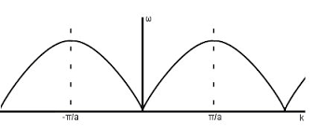
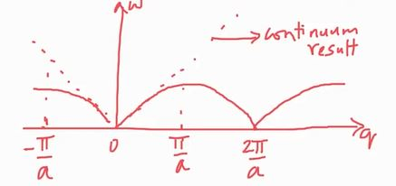
Mono Atomic lattice-final result
dispersion relation-nearest neighbours only

Slide 17
Mono atomic lattice-final result
The continuum and discrete result are identical at small value of the q.
When q=π/a different. There is deviation those value of q.
Periodicity because of sin function, region betn -π/a and π/a is called brillouine zone.

Slide 18


Observations
1.In the long wavelength limit (small k),
Linear dispersion = continuous description is applicable
speed of sound

Slide 19
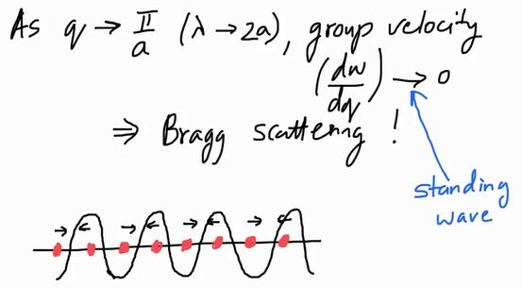
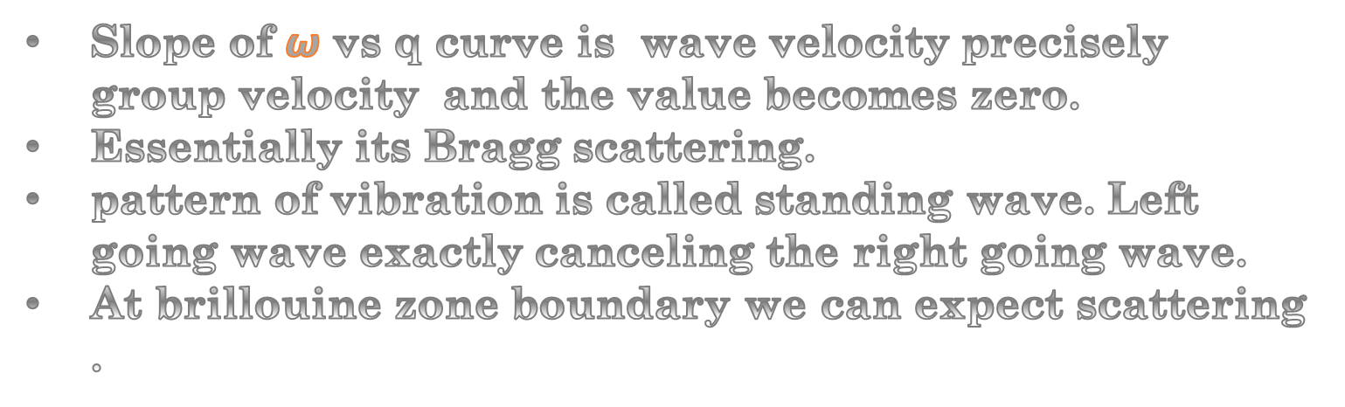
Obervations- what happens ?
Slope of $ω$vs q curve is wave velocity precisely group velocity and the value becomes zero.
Essentially its Bragg scattering.
pattern of vibration is called standing wave. Left going wave exactly canceling the right going wave.
At brillouine zone boundary we can expect scattering .

Slide 20
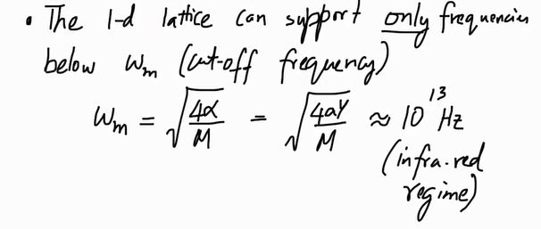
Obervations
Frequency of phonon cant keep rising infinitely. There is upper cutoff which is corresponds to the infra-red region.
we use infrared rays to map out the vibrational density of states of solids in Raman spectroscopy

Slide 21
What happens when you have more than one atom associated with lattice points?
This question gonna make us to add a new feature to this dispersion relationship.
I,e 1d Mono atomic lattice to 1d Diatomic lattice

Slide 22
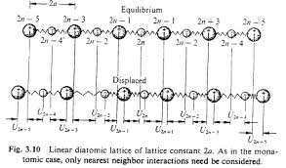
Diatomic lattice
What if two atoms have same masses.ie m1=m2
What would be the dispersion relationship?

Slide 23
Diatomic lattice
Case 2:
m1=m2,but lattice parameter is 2a .it means two atoms per basis we have 1d lattice with 2a lattice parameter.
What would be the dispersion relationship?

Slide 24
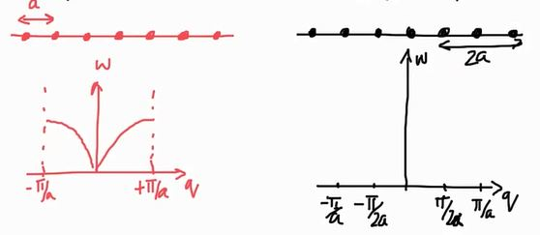
One dimensional Diatomic lattice
In this two cases ‘a’ is physically equivalent to ‘2a’.
In addition -π/2a and π/2a.
Reciprocal lattice is a*=2π/2a.
Brillouine zone in this case 0 to π/a ie -π/2a and π/2a.

Slide 25


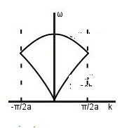
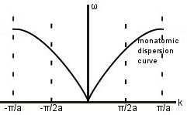
One dimensional Diatomic lattice
Zone folding

Slide 26
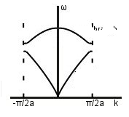
One dimensional Diatomic lattice
If the two types of atom have different masses, a gap opens up between the two branches.

Slide 27


One dimensional Diatomic lattice
The equation of motion
With wave solution

Slide 28


One dimensional Diatomic lattice
The solution of the diatomic lattice is
When k=0,ω =0 in lower soln and upper soln is non zero.
When q=π/2a,we get different soln.

Slide 29

One dimensional Diatomic lattice
The solution of the diatomic lattice is
When k=0,ω =0 in lower soln and upper soln is non zero.
When q=π/2a,we get different soln.

Slide 30
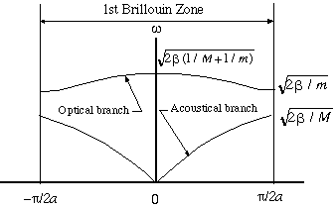
One dimensional Diatomic lattice
Now we have two branches acoustic(lower) and optical (upper)

Slide 31



Why it is acoustic and optical mode? How?
Acoustic branch :setting ω=0 in this{mentioned} equation. This equation will be satisfied only if A=B
Optical branch :setting ω= in this{mentioned} equation.
We get ,
A1M1 + A2M2=0
………………………….
………………………….

Slide 32

Why its is acoustic and optical mode? How?
In the case of Acoustic branch
if A=B atoms are moving in the same direction. The Net Dipole Moment does not change that much..
In the case of Optical branch
A1M1 + B2M2=0 which represents atoms are moving in opposite direction. So, the Net Dipole Moment changes drastically.
If Net Dipole Moment oscillating quite violently ,this type of vibration pattern exited by a electromagnetic wave.
That why it is called Optical branch.

Slide 33
Part-2 Phonon calculation in quantum espresso

Slide 34
Phonon calculation in quantum espresso
scf
Dynamical matrix
Acustic sum rule
Phonon frequency
Phonon density of states

Slide 35
Phonon calculation in quantum espresso
Aim - find dispersion relation ie relationship betn w and k.
- Density of states
How to find frequency w?

Slide 36
Phonon calculation in quantum espresso
DFT
Phonon frozen method
drawback large supercells are needed
accurately calculate the force constant matrix-
cause problems
large time of calculation.

Slide 37
Frozen Phonons
The forces between every atom construct the force constant matrix in the crystal. This force constant matrix then allows us to calculate the normal modes of at any particular wavevector q.
DFT to calculate the forces on every atom using the Hellman-Feynman theorem.
This method of calculating the force constant matrix by explicitly displacing atoms is called the Frozen-Phonon method.

Slide 38
Frozen Phonons
Advantage
Quicker and computationally cheaper than the Linear Response method, which utilizes DFPT to calculate forces.
Drawback
Large super cells - needed to accurately calculate the Force constant matrix.
Boundary conditions used in DFT calculations cause problems -frozen phonon method.

Slide 39
Phonon calculation in quantum espresso
Scf-total energy
Interatomic force constant
Dynamical matrix
Phonon frequency

Slide 40
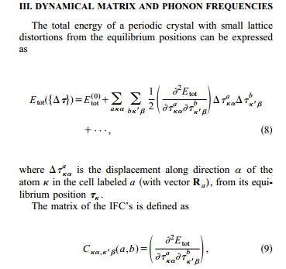
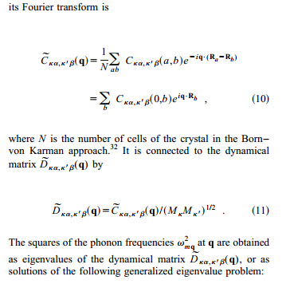
Dynamical matrix

Slide 41
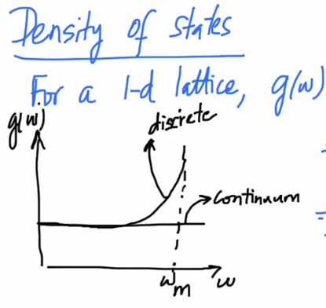
This is what DFPT…..
Dynamical matrices are known - can generate easily IFC using Fourier transformation and phonon frequencies interpolated for any wave vectors.
Phonon density of states
Its same as the density of states in DFT.

Slide 42
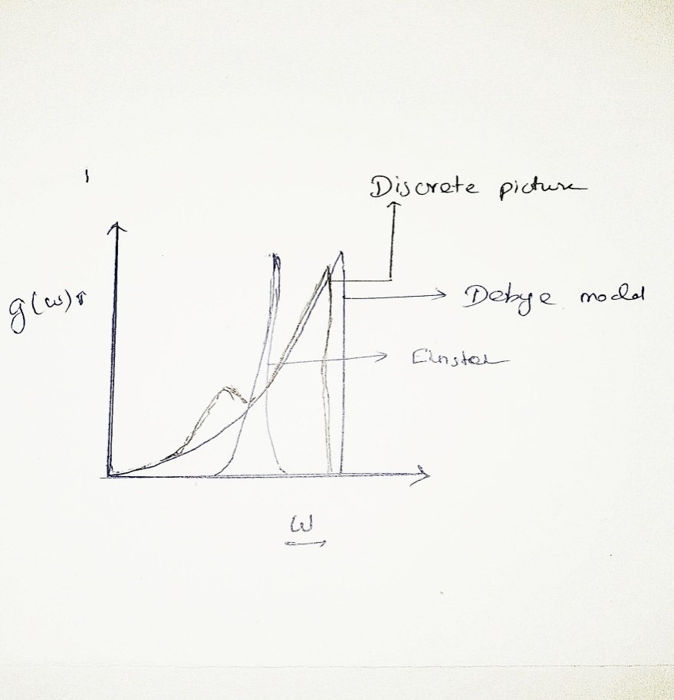
Einstein and Debye model
Debye model almost same as Discrete picture.
Debye model gives very good agreement in treating of specific heat of solid.

Slide 43
Part-3
Program files and results

Slide 44
Simulation
The Multiple Phonon simulation in Quantum Espresso consists of four steps:
Step 1. PWSelf consistent calculation of electron density. Outputs are wave functions.
Step 2. PHPhonon calculation from linear response, with output on a rough grid.
Step 3. Q2RFourier transform to real space and obtain force constants by interpolation.
Step 4. MATDYNCalculation of all phonons from dynamical matrix, given the force constants.

Slide 45
Self consistent calculation
&control calculation='scf‘
……….
………. outdir='/home/k / &system ……….
………. / &electrons
……… / ATOMIC_SPECIES ……..
ATOMIC_POSITIONS ……..
K_POINTS AUTOMATIC
4 4 4 1 1 1
It calculates the total energy of a periodic crystal from its equilibrium position.
This total energy help us to find IFC

Slide 46
Calculation of Dynamical matrices on a grid of q-vectors (will require several minutes).
Phonons of Si at X &inputph tr2_ph=1.0d-14, amass(1)=28.0855, prefix='SIPH', ldisp=.true outdir='/home/kathirvel/espresso/tmp/' fildyn='si.dynX', / 4.0 4.0 4.0
Threshold
amass(i), i-atomic mass of atomic type. i=1,2,3…
Same prefix as in the Scf calculation
To calculate tensor and dielectric constant
File containing dynamical matrix
q vector dense grid
Prompt> mpirun –np 8 ph.x < si.ph.in > si.ph.out

Slide 47
Calculation of IFC's in real space.
&input fildyn='si.dynX', zasr='simple', flfrc='si444.fc' /
file containing dynamical matrix
To impose acoustic sum rules
File containing the IFC's, and a list of q-points for which the frequencies are to be calculated
prompt> mpirun –np 8 matdyn.x <input file> output file

Slide 48
The calculation of Phonon dispersions along selected high-symmetry lines
&input asr='simple', amass(1)=58.6934, flfrc='ni444.fc', flfrq='ni.freq' / 36 0.0 0.0 0.0 0.0 0.1 0.0 0.0 0.0
………………..
Indicate type of Acoustic Sum Rules used for the Born effective charges
File where matdyn writes the interpolated frequencies
High symmetry k points
prompt> matdyn.x <input file> output file

Slide 49
The calculation of Phonon DOS
&input asr='simple', dos=.true. amass(1)=58.6934, flfrc='ni444.fc', fldos='ni.phdos', deltaE=1.d0, nk1=6,nk2=6,nk3=6 /
Dos calculation, default set ‘true’
DOS written file
Energy level
The grid of q-vectors used to calculate the DOS ( "nk1", "nk2", "nk3",using the Monkhorst-Pack logic).
Prompt> matdyn.x < phdos.in > phdos.out

Slide 50
Things you need to know………………………..
Self-consistent field
Dynamical matrix
Scf step as usual.
Prefix of the Scf and all ph,q2r,freq,phdos should be same.
Note : relaxation prefix would be visible to phonon calculation so, prefix of relax and Scf must be different if you do sequence calculation of Phonon. As per my experience it happened when I did dynamical matrix calculation, It took Energy values with ‘K’ points from relax calculation not from Scf.
In the calculation of Dynamical matrix If grid of q-vectors increases, program running time will also increases.(not to specify more than 4).
Form the output of Dynamical matrix calculation (flfrc='grap.fc‘-contains force constant)we can calculate Acoustic Sum Rule.

Slide 51
In matdyn calculation we can proceed to two different types of calculations which are mentioned below.
1.Phonon dispersions
2.Phonon DOS
In this matdyn.in calculation we must to specify the list of q-points for which the frequencies are to be calculated. These q points can be generate from X-crysden which are in crystal co-ordinates ,actual need is Cartesian co-ordinates in the units of 2pi/a.
To get this Cartesian co-ordinates we calculated band structure for given atom using high symmetry points in crystal co-ordinates which is generated from X-crysden. From the output file of band structure calculation,we could extract Cartesian co-ordinates which is in the units of 2pi/a.
we can use these co-ordinates as a high symmetry q points for which the frequencies are to be calculated( matdyn.in).
The file selected in flfrc, "si.freq", contains a list of frequencies in a format that can be further processed by another auxiliary code, "plotband.x", the same used for band structure plotting.
If you choose option "dos=.true." you must specify the grid of q-vectors used to calculate the DOS.

Slide 52
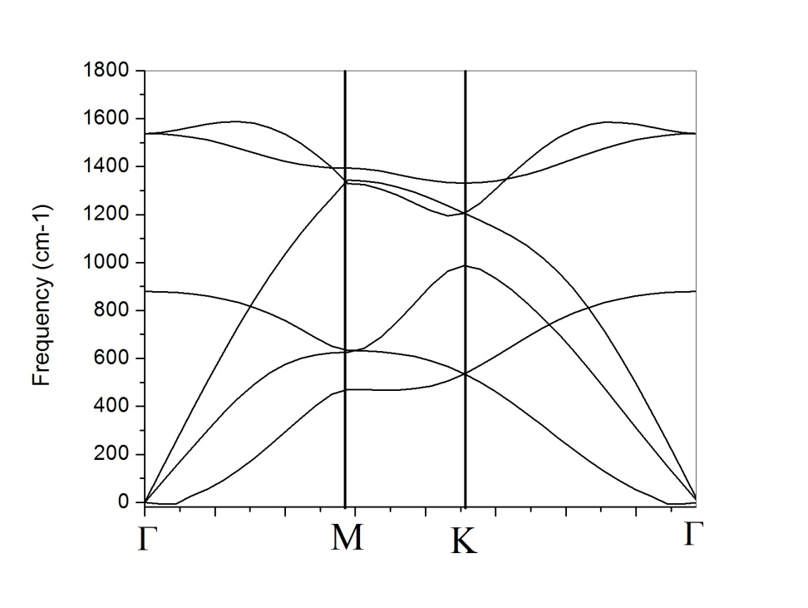
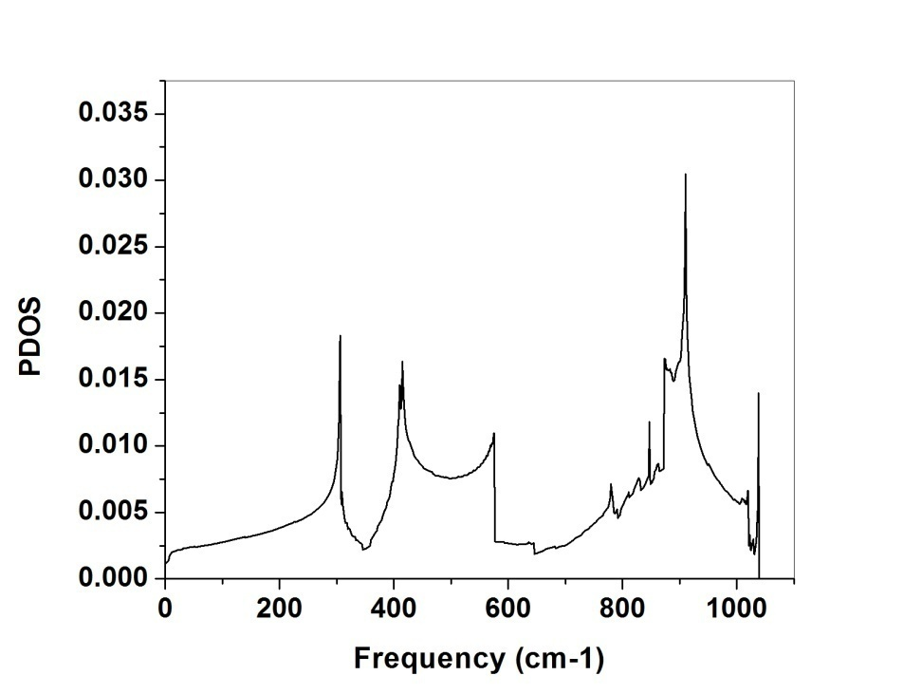
Phonon calculation for Graphene
Phonon dispersion
Phonon density of states

Slide 53
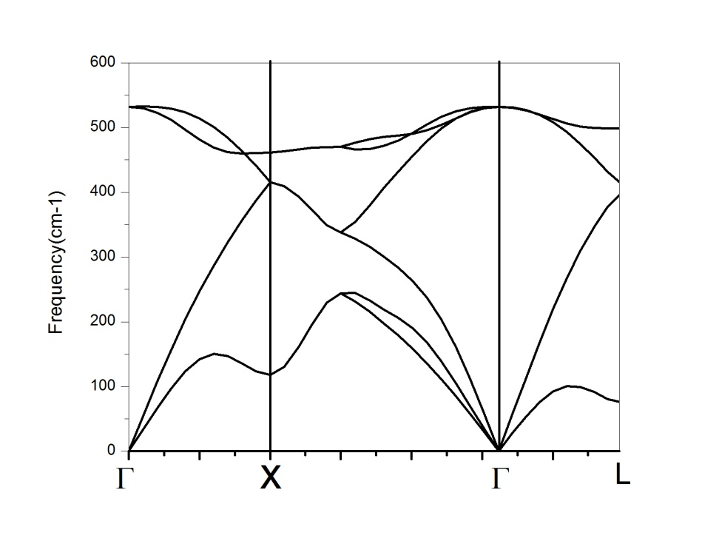
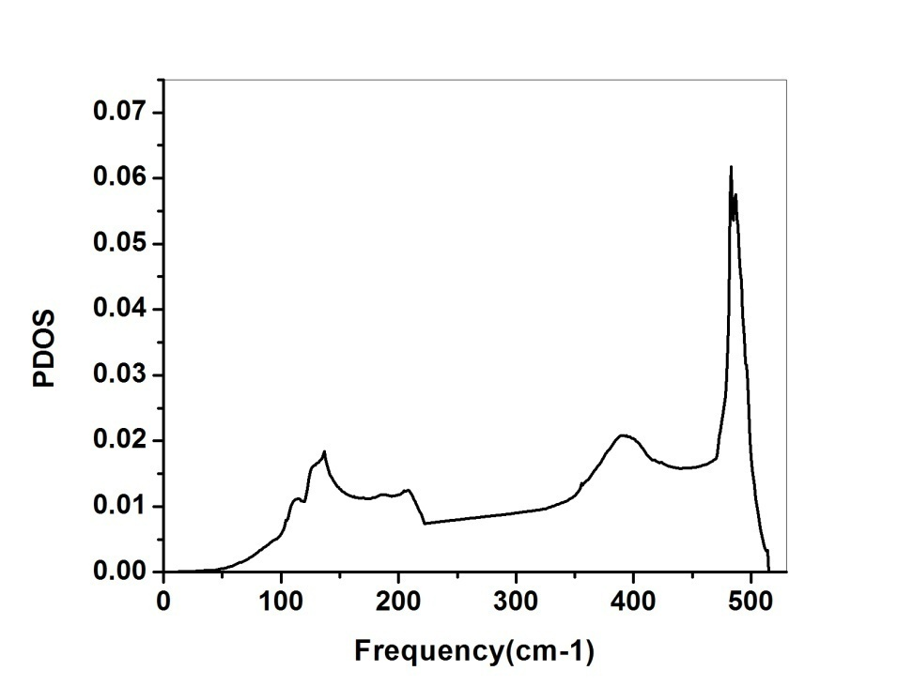
Phonon calculation for Silicon
Phonon dispersion
Phonon density of states

Slide 54
Thank you….

